Slide 1
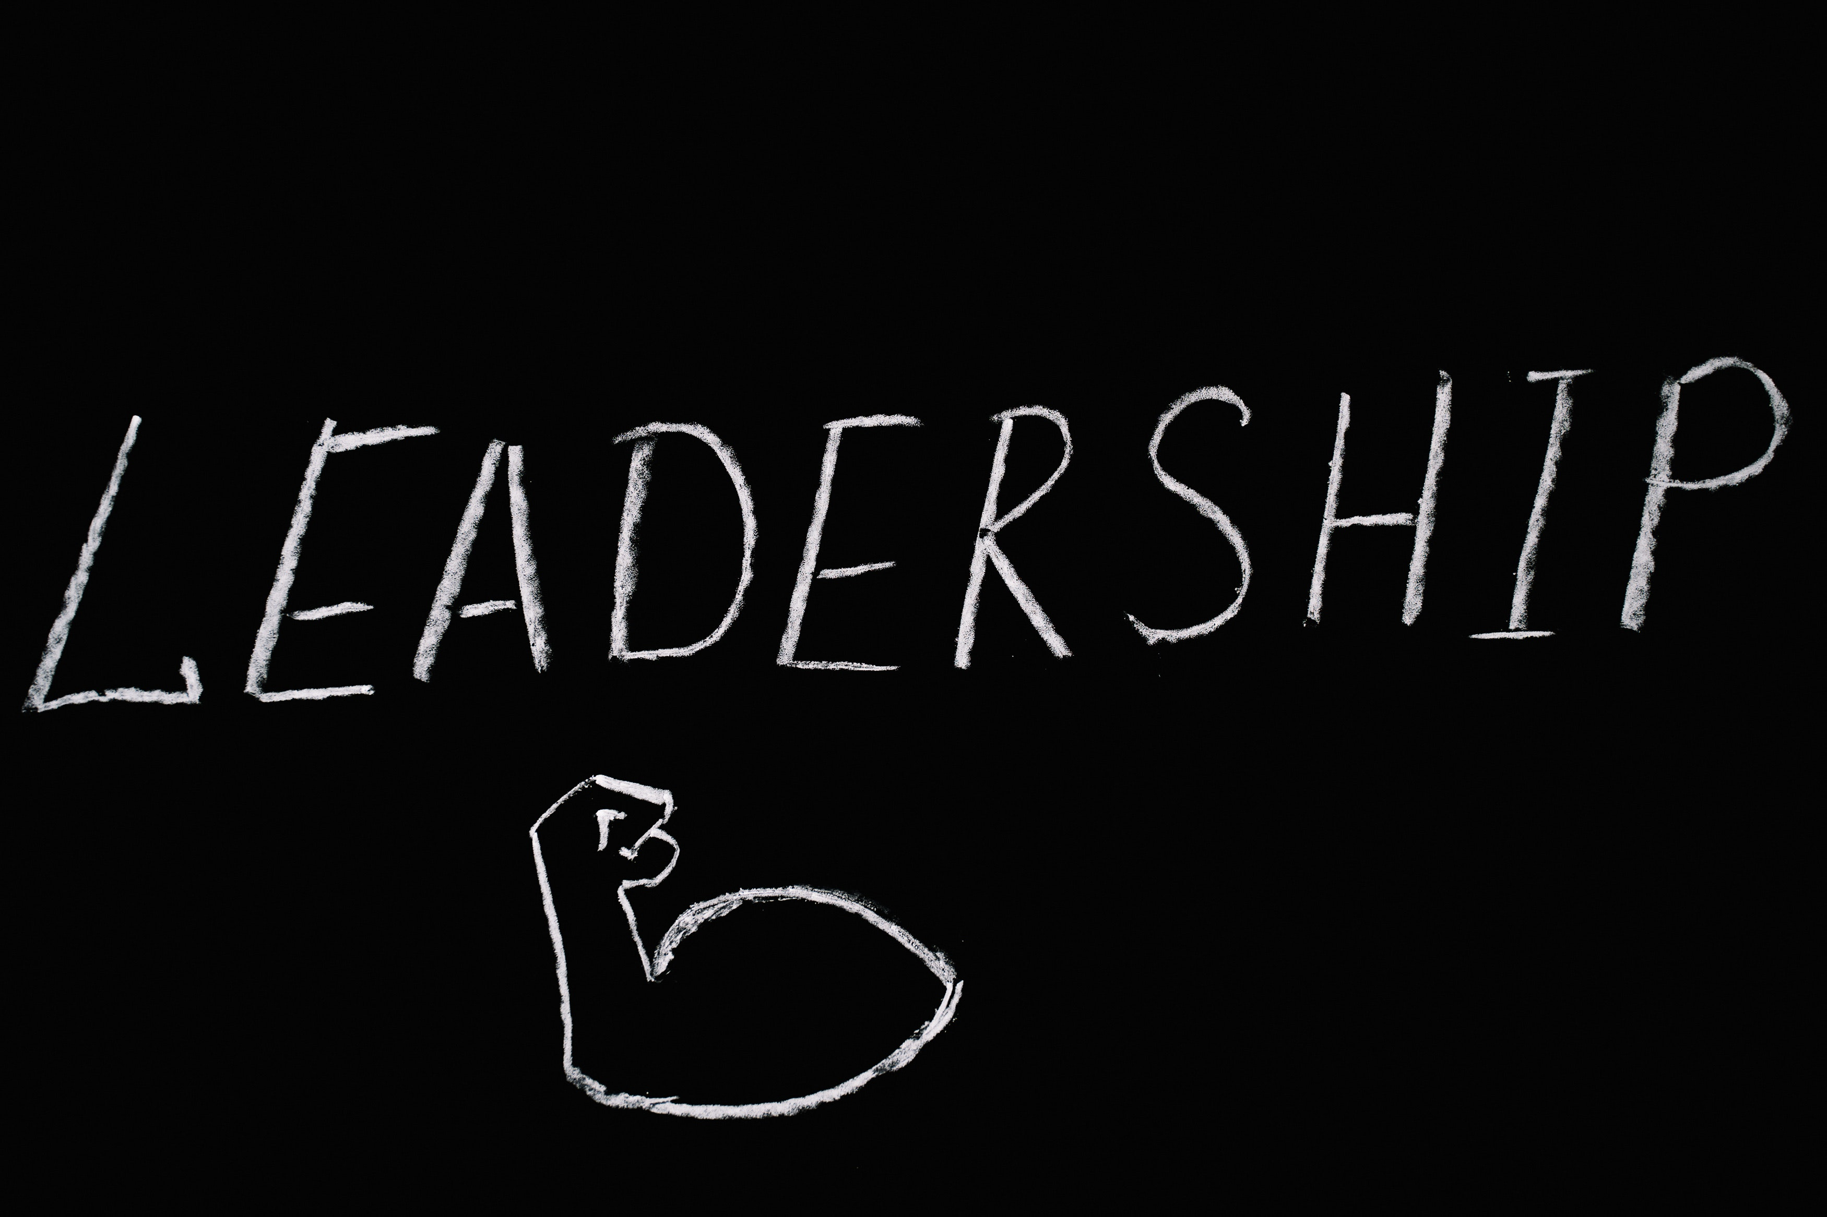

Slide 2
LEADERSHIP
&
ITS TYPES
BY PRAGYAN PANDIT

Slide 3
Leading
Leading or leadership is the glue that allows for the coordination of people toward a common goal or collective response to a situation.
Leading involves influencing others through direction, inspiration, and motivation toward the attainment of organizational objectives
Leaders generally use some form of power or influence over individuals to affect their behaviour
A leader can be the source of motivation or cause the motivation (whatever its source) to inspire and direction
Leading is distinct from the organizing function of management, which generally includes arranging or assembling resources
Leading is one of the management core functions. Here, a manager spends time connecting with his/her employees. Leadership skills include inspiring, communicating, motivating, and influencing employees for efficient output. All managers are not leaders, but all leaders are managers. An employee follows all the directions a manager gives because they have to, because managers have all the legitimate powers. But an employee voluntarily follows the direction of a leader because they have believed in him\her.

Slide 4
SO What is Leadership ?
Leadership is essentially a continuous process of influencing behavior. It may be considered in context of mutual relations between a leader and his followers.
The leader tries to influence the behavior of individuals or group of individuals around him to achieve desired goals.
Leadership is a dynamic process, which deserves study. It is a relational process involving interactions among leaders, members and sometimes outside constituencies.

Slide 5
Characteristics of leadership
Dependent on the situation
Influence the behaviour of others
Attainment of common organizational goals
Group process
Inter-personal process
Continuous process

Slide 6
Influence the behaviour of others: Leadership is an ability of an individual to influence the behaviour of other employees in the organization to achieve a common purpose or goal so that they are willingly co-operating with each other for the fulfilment of the same
.
Inter-personal process: It is an interpersonal process between the leader and the followers. The relationship between the leader and the followers decides how efficiently and effectively the targets of the organization would be met.
Attainment of common organizational goals: The purpose of leadership is to guide the people in an organization to work towards the attainment of common organizational goals. The leader brings the people and their efforts together to achieve common goals.
Continuous process: Leadership is a continuous process. A leader has to guide his employees every time and also monitor them in order to make sure that their efforts are going in the same direction and that they are not deviating from their goals.
Group process: It is a group process that involves two or more people together interacting with each other. A leader cannot lead without the followers.
Dependent on the situation: It is situation bound as it all depends upon tackling the situations present. Thus, there is no single best style of leadership.

Slide 7
Building Morale and satisfaction
Providing Motivation
Initiating Action
Co-ordination
Importance Leadership
Providing guidance
Ensuring Proper Work Environment
Creating confidence

Slide 8
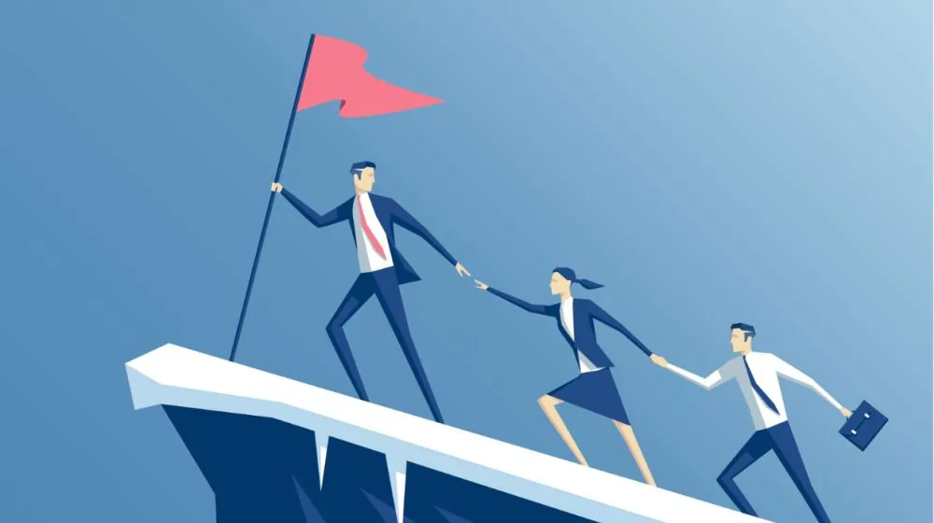
TYPES OF LEADERSHIP
Autocratic Leadership.
Democratic leadership
Laissez-faire Leadership.
Transformational Leadership.
Transactional Leadership.

Slide 9
Autocratic leadership
Takes all decision himself.
Does not delegate authority.
Exercise complete control over subordinates.
Just give orders to sub-ordinates and they need to follow him unquestioning.
Centralize power in himself.
Give reward and put penalty.
One way Communication ( doesn’t share information with sub-ordinates.)

Slide 10
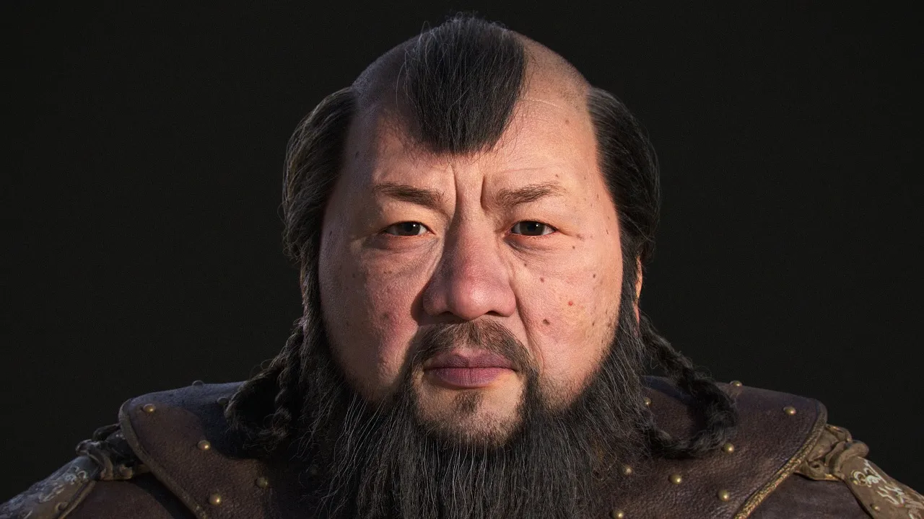
Genghis khan
Genghis Khan was the founder and first Great Khan of the Mongol Empire, which became the largest contiguous empire in history after his death. He came to power by uniting many of the nomadic tribes of the Mongol steppe and being proclaimed the universal ruler of the Mongols, or Genghis Khan

Slide 11
Democratic Leadership
Also known as Participative leadership.
Consult Sub-ordinates while talking decisions.
Delegates and decentralize authority.
Listen to suggestions, ideas and opinions of sub-ordinates.
Delegates responsibility according to capability of sub-ordinates.
This is as clear as its name. In democratic leadership, the leaders make or break decisions democratically, based on their team’s opinion and feedback. Although it is the leader who makes the final call, every opinion counts. This is easily one of the most effective leadership styles since it allows employees to have a voice.

Slide 12
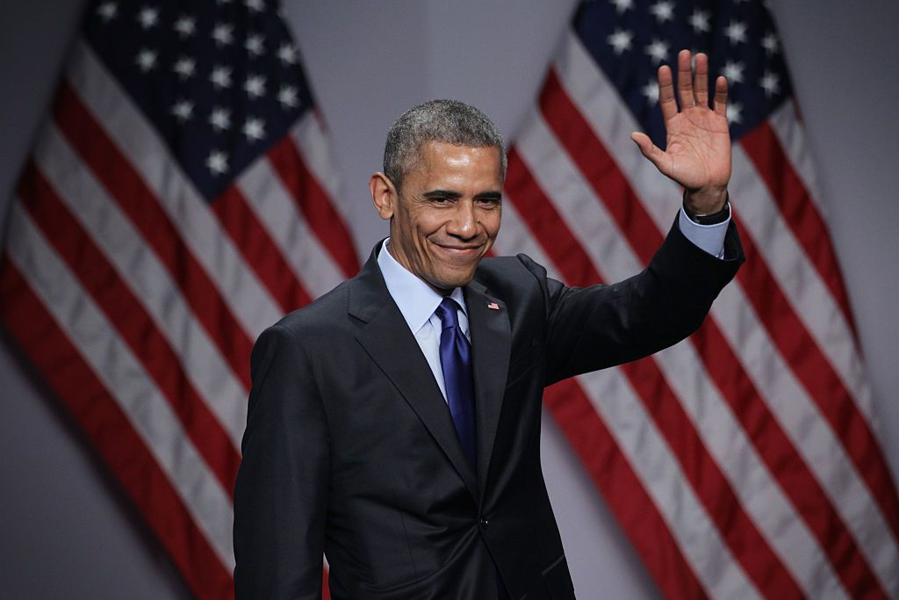
Barack Obama
Barack Hussein Obama II is an American politician who served as the 44th president of the United States from 2009 to 2017. A member of the Democratic Party, Obama was the first African-American president of the United States.

Slide 13
Laissez- Faire leadership
Follow “LET THEM DO” policy.
Leader just provide information's and resources needed to sub-ordinates.
Leader avoids power.
Does not interfere in making plans and policies.
Sub-ordinates have full freedom in taking decisions.
Extreme version of Democratic leadership.

Slide 14
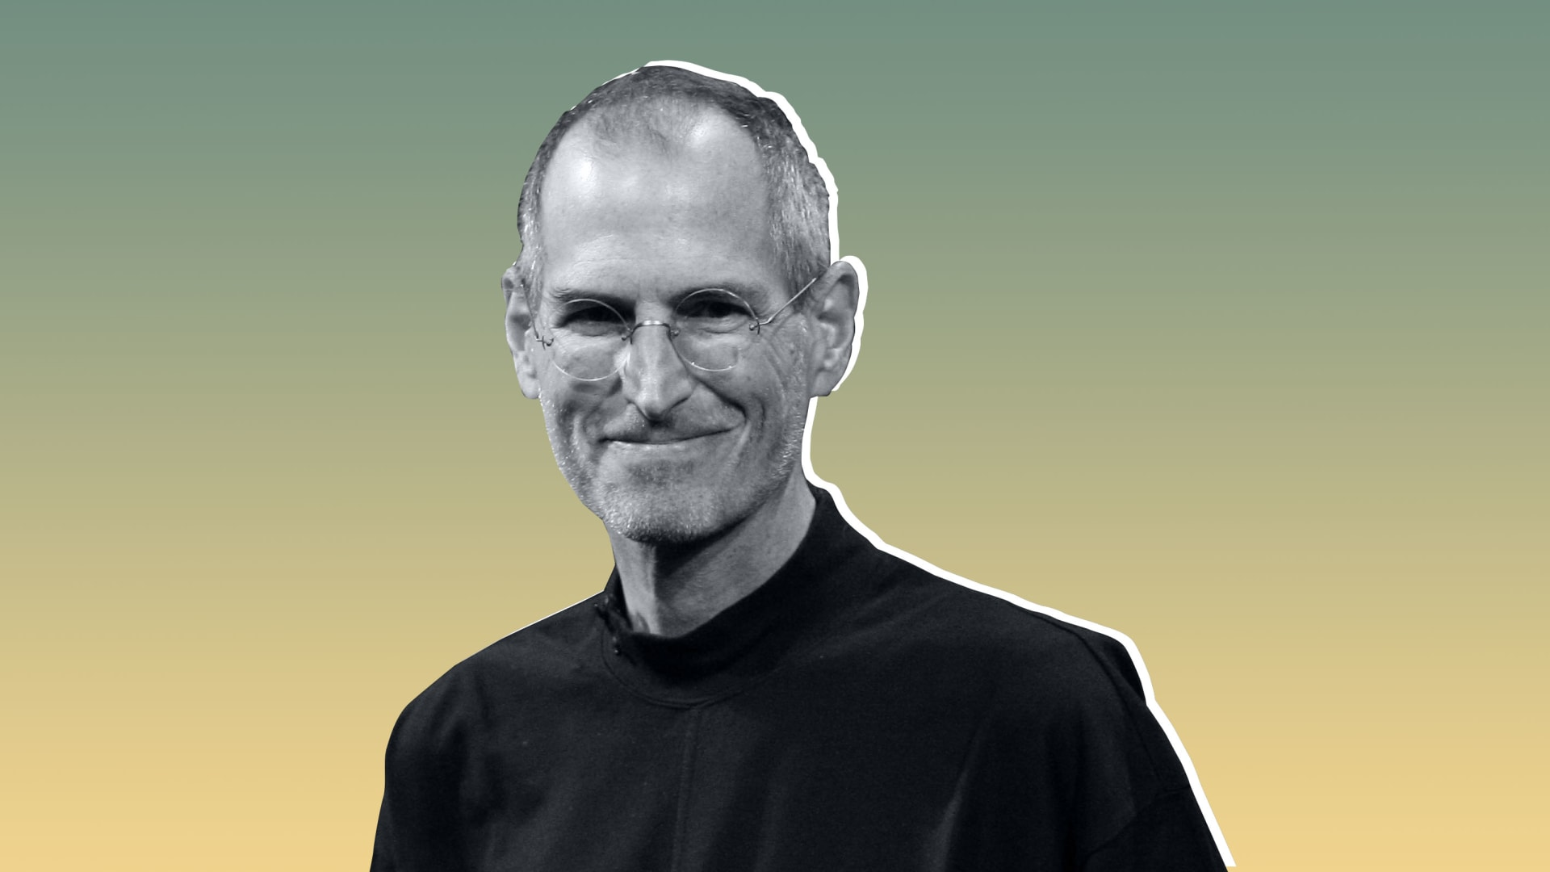
Steve Jobs
Steven Paul Jobs was an American entrepreneur, industrial designer, media proprietor, and investor. He was the co-founder, chairman, and CEO of Apple for (1955-2011)

Slide 15
Trasnformational Leadership
Provide mission and vision to the Sub-ordinates.
Leadership that relies on the encouragement on a team to realize a overall success.
Focused on motivation for employees to create change, innovate and shape the future of the organization.
Promotes intelligence and rationality.
Coaches and Advice.

Slide 16
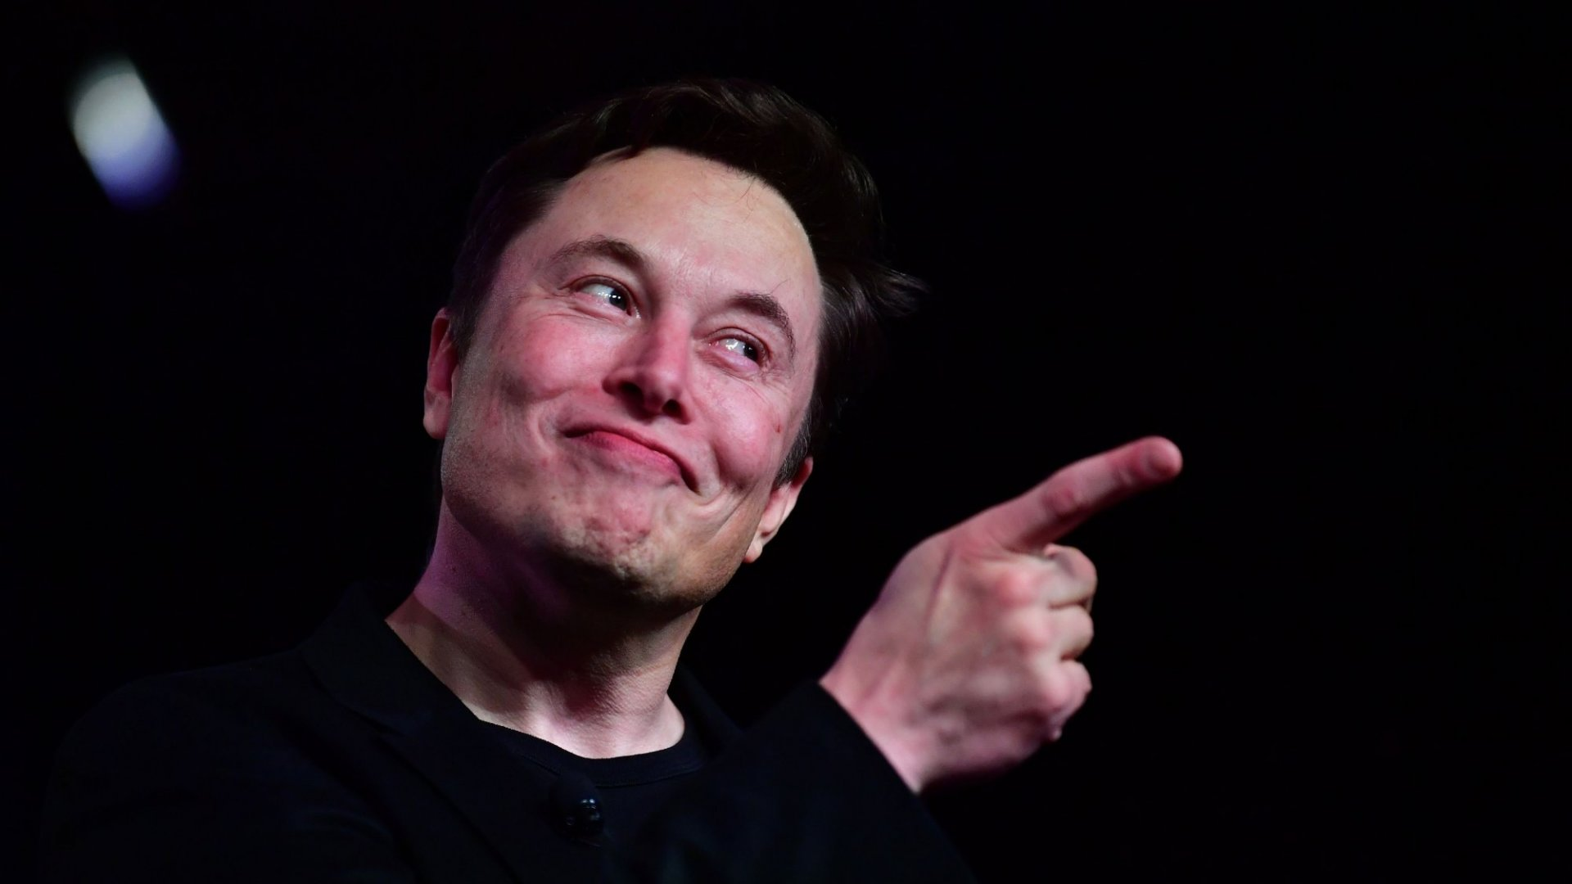
Elon Musk
Elon Reeve Musk FRS is a business magnate and investor. He is the founder, CEO and chief engineer of SpaceX, angel investor, CEO and product architect of Tesla, Inc., owner and CEO of Twitter, Inc.

Slide 17
Transactional Leadership
Establishing clearly defined criteria for good performance and and anticipated reward.
Uses reward and punishment to motivate Sub-ordinates.
Full freedom to Sub-ordinates and only intervene when standards are not fulfilled.
Establish role and responsibilities for each employee and ensure standard output.
Monitoring to evaluate compliances and success or non-compliances.

Slide 18
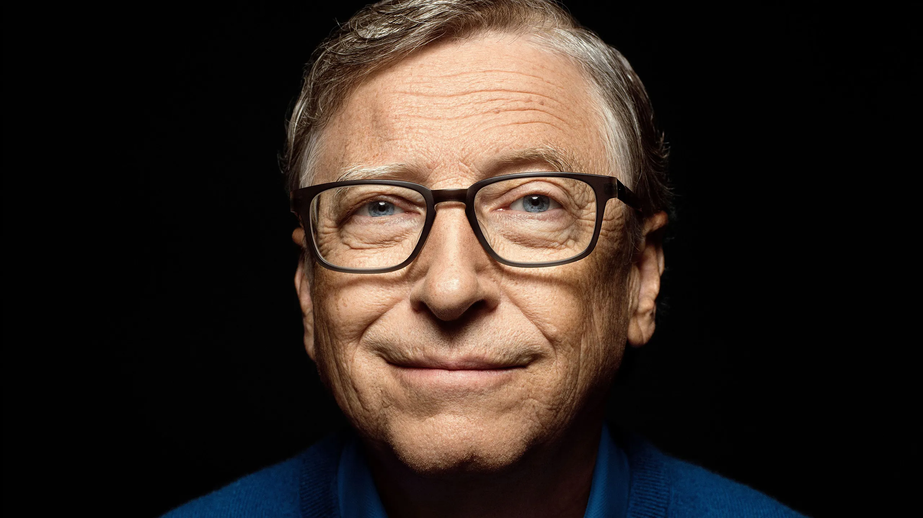
Bill Gates
William Henry Gates III is an American business magnate and philanthropist. He is a co-founder of Microsoft, American computer programmer, businessman, and philanthropist.

Slide 19
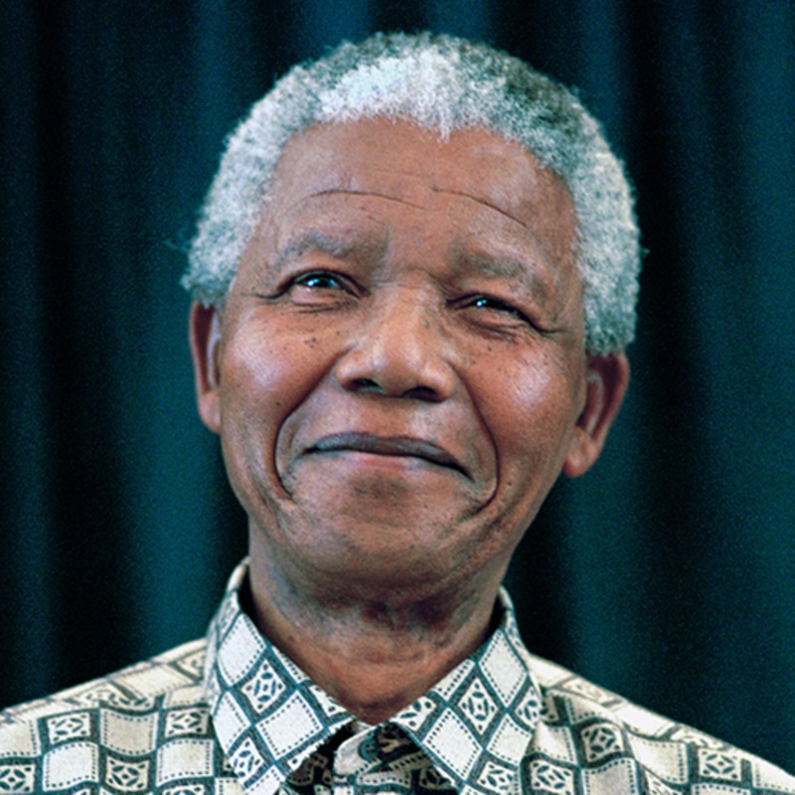
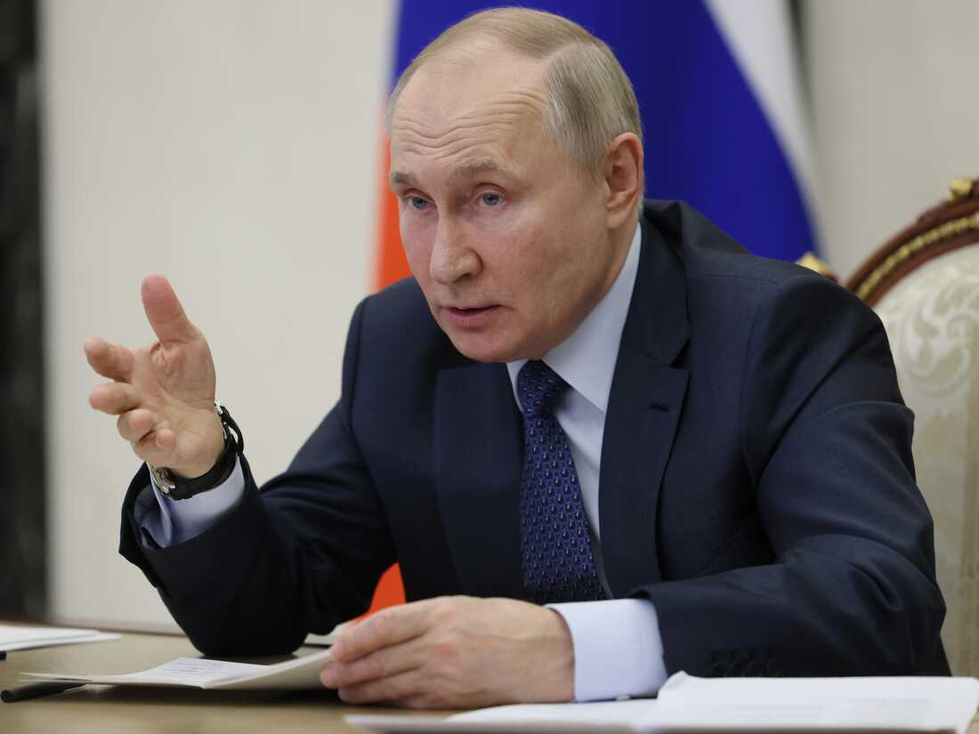
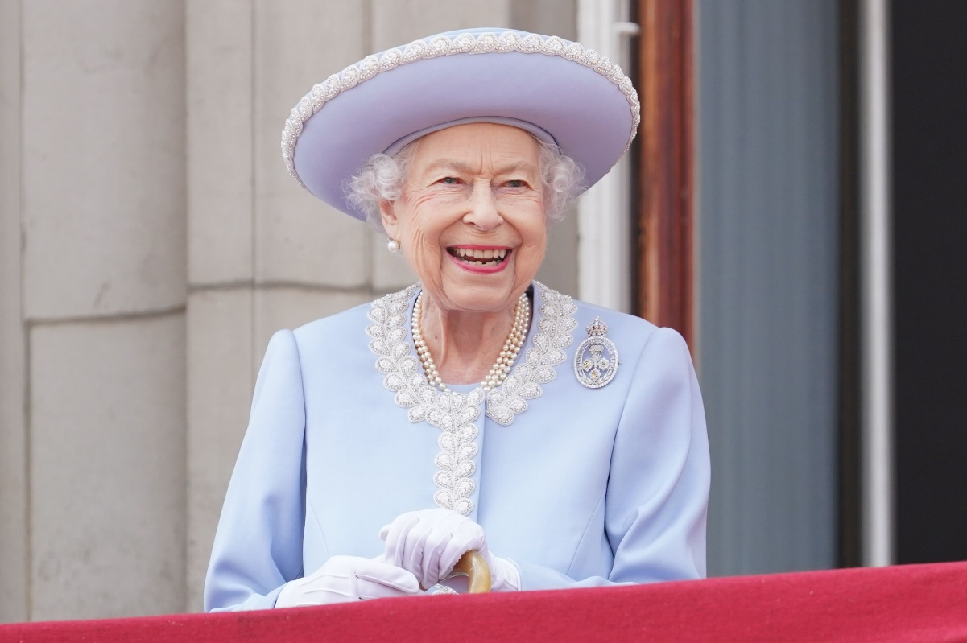
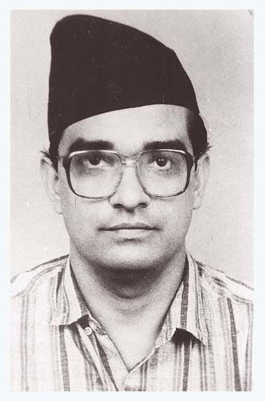
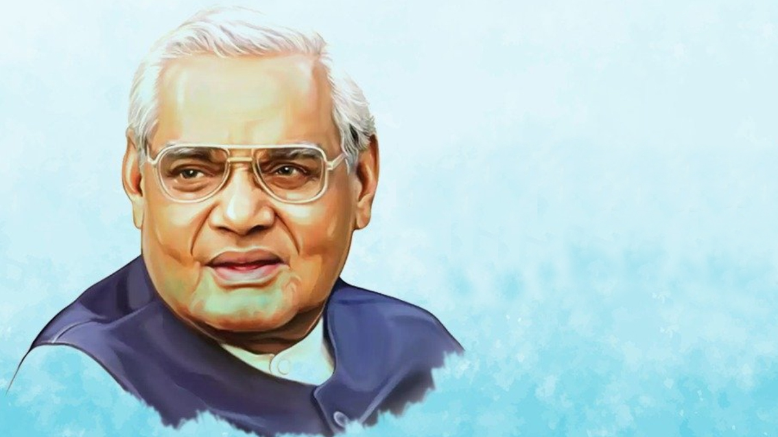
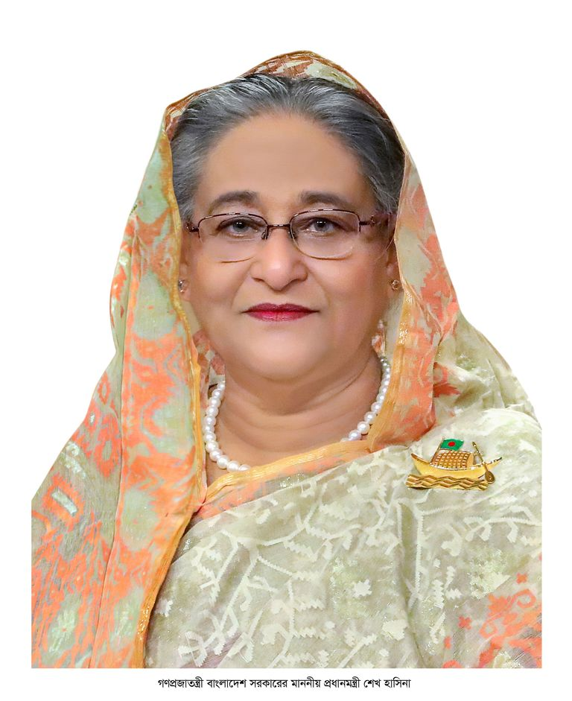

Slide 20
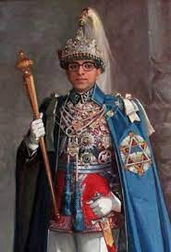
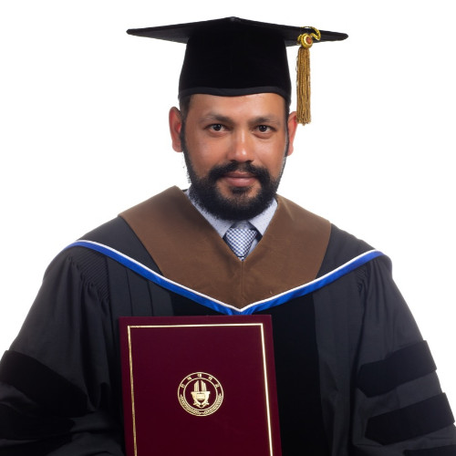
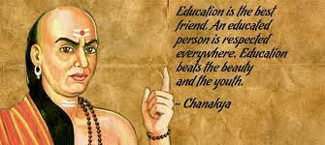
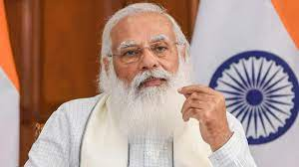
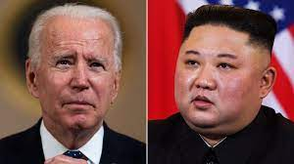
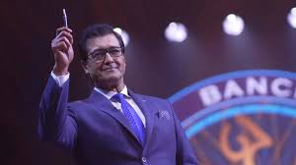
धन्यवाद

